Slide 1
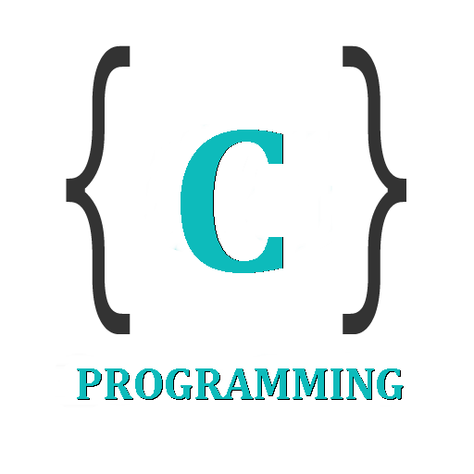

IT 105: Introduction to Programming
Dr. Manish Khare
Dr. Saurabh Tiwari
Lecture 11

Slide 2
do-while Loop
The do-while loop looks like this:
do
{
this ;
and this ;
and this ;
and this ;
}
while (this condition is true);

Slide 3
There is a minor difference between the working of while and do-while loops.
  This difference is the place where the condition is tested.
  The while tests the condition before executing any of the statements within the while loop.
  As against this, the do-while tests the condition after having executed the statements within the loop

Slide 4
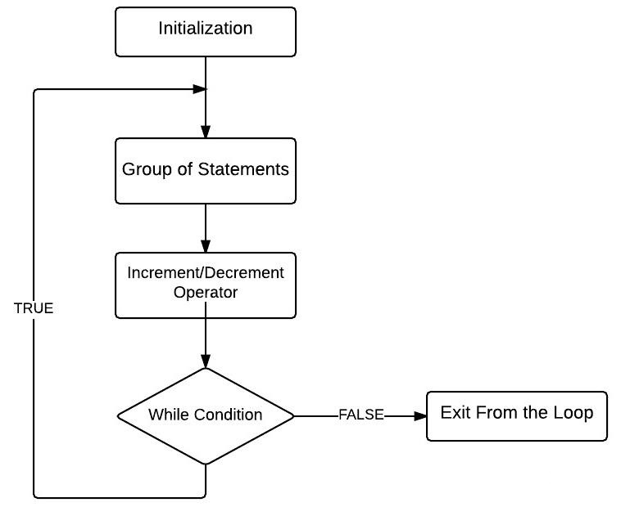

Slide 5
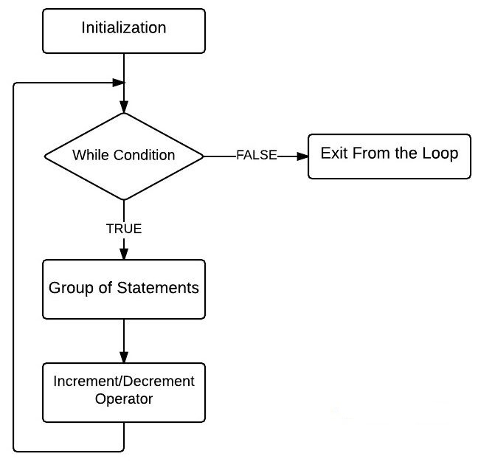

Slide 6
This means that do-while would execute its statements at least once, even if the condition fails for the first time.
The while, on the other hand will not execute its statements if the condition fails for the first time.
This difference is brought about more clearly by the following program

Slide 7
main( )
{
while ( 4 < 1 )
printf ( "Hello there \n") ;
}
Here, since the condition fails the first time itself, the printf( ) will not get executed at all.
Let's now write the same program using a do-while loop.

Slide 8
main( )
{
do
{
printf ( "Hello there \n") ;
}
while ( 4 < 1 ) ;
}
In this program the printf( ) would be executed once, since first the body of the loop is executed and then the condition is tested.
https://ideone.com/0MC9fj

Slide 9
How many times will the string "Here" be printed?
count1 = 1;
while (count1 <= 10)
{
count2 = 1;
while (count2 <= 20)
{
printf("Here");
count2++;
}
count1++;
}
Notes:
10*20

Slide 10
An Extension in Modern C Compilers
The following construct (not in book) is legal in C99:–
  for (int i = 0; i < limit; i++){
  expression involving i;
  ...;
  printf(“Iteration %d completed.\n”, i);
  ...;
  }
The loop counter i is declared in for loop
    Not visible outside of loop!
Common practice
    Good programming style

Slide 11
Notes on Loop Style
for (int i = 0; i < limit; i++) {
...; /*prepare for subgroup i*/
for (int j=0; j < limit2; j++) {
...;
/* do something with item j of
subgroup i*/
...;
} /* end of loop j */
...;
} /* end of loop i */
Declare loop variables in for-statements – C99

Slide 12
Notes on Loop Style
for (int i = 0; i < limit; i++) {
...; /*prepare for subgroup i*/
for (int j=0; j < limit2; j++) {
...;
/* do something with item j of
subgroup i*/
...;
} /* end of loop j */
...;
} /* end of loop i */
Include a comment at end of each loop to show which loop it is

Slide 13
Statements are True?
main( )
{
int x = 10, y = 100%10;
for (i=1; i<=10; i++)
if (x!=y);
printf ("x=%d y=%d\n", x, y) ;
}
printf() function is called 10 times
Output x=10, y=10
The program not produce any error
No output
printf() infinite times
Notes:
3 3 1

Slide 14

Program?
Write a program to add first seven terms of the following
series using a for loop:
Notes:
3 3 1

Slide 15
Program?
Write a program to generate all Pythagorean Triplets with side less than or equal to 30.
Notes:
3 3 1

Slide 16
Summary
The three type of loops available in C are for, while, and do-while.
A break statement takes the execution control out of the loop.
A continue statement skips the execution of the statements after it and takes the control to the beginning of the loop.
A do-while loop is used to ensure that the statements within the loop are executed at least once.

Slide 17
Example Using a break Statement
while (1) {
scanf(“%lf”, &x);
if (x < 0.0)
break;
printf(“%f\n”, sqrt(x));
}
/* break causes jump to next statement */
/* after the while loop. */

Slide 18
Example Using a continue Statement
while (cnt < n) {
scanf(“%lf”, &x);
if (x > -0.01 && x < +0.01)
continue; /* disregard small values */
++cnt;
sum += x;
/* continue transfers control to */
/* here to immediately begin the */
/* next iteration. */
}

